Slide 1

Variables

Slide 2
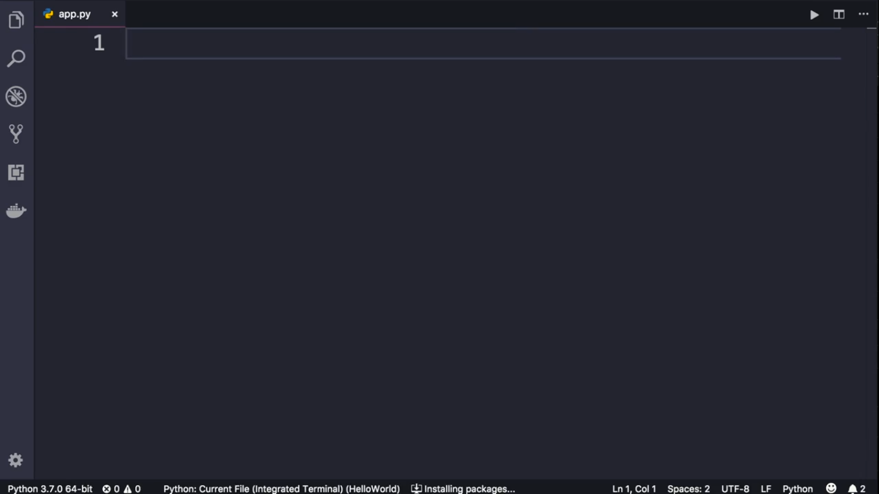
We use variables to store data in computer’s memory

Slide 3
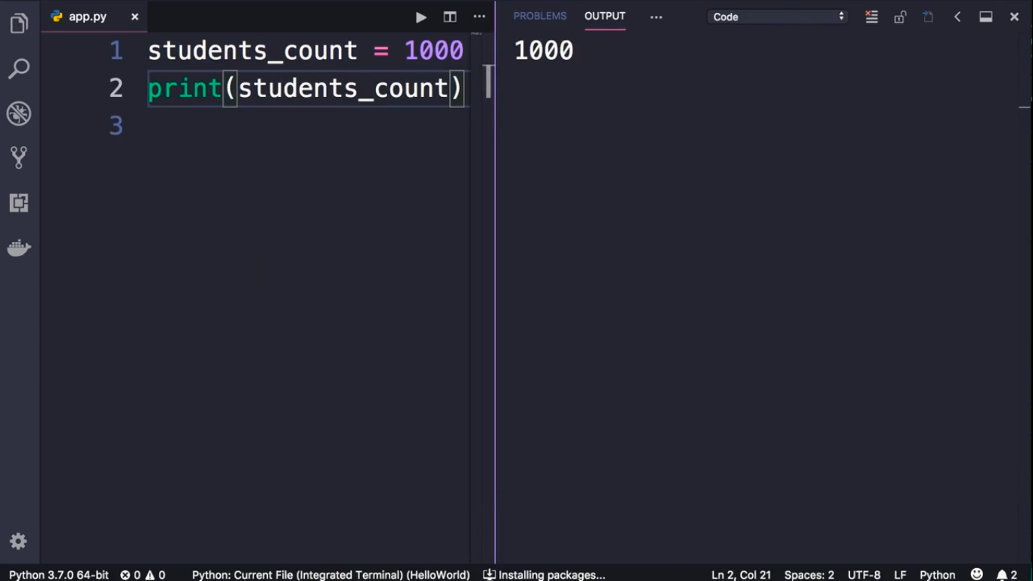

Slide 4
